Slide 1
Predictive Model
Exploring Factors Influencing Buying Behaviour
Presented by
Blessing Oriaguaman
March 2025

Slide 2
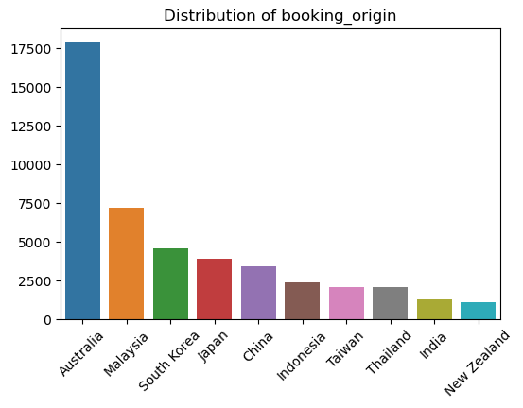
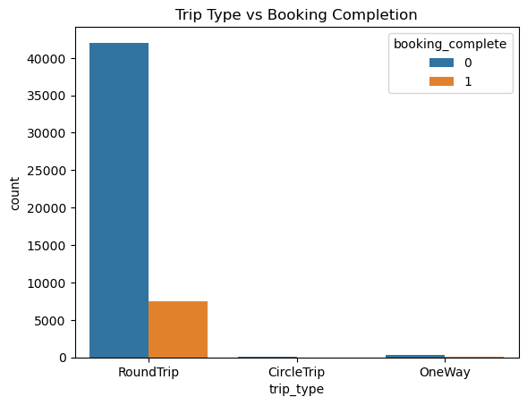
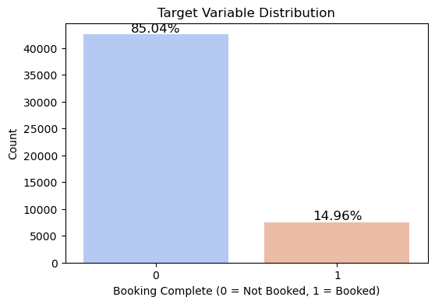
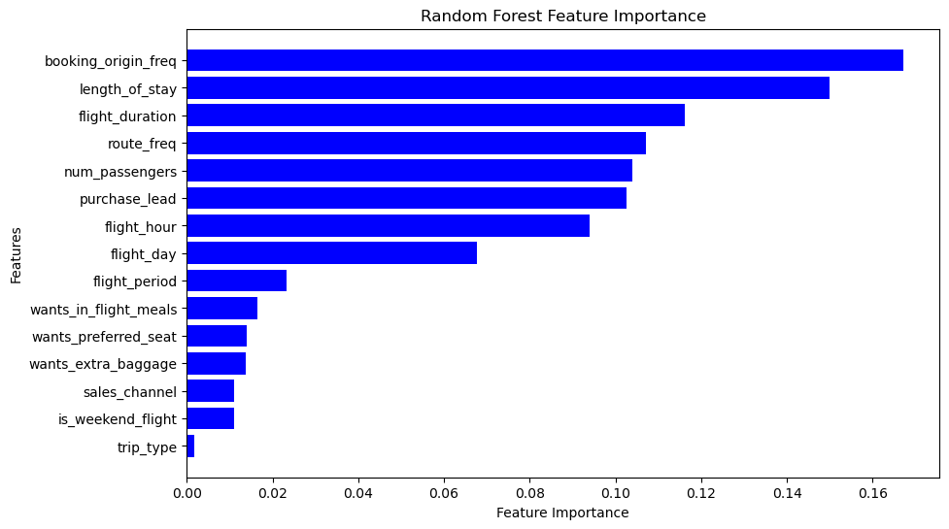
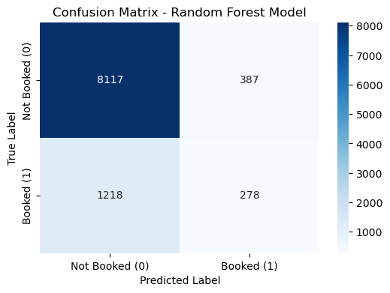
Cross-validation accuracy:
0.9058 ± 0.1101
(Approx. 91%)
Model Performance on Test set
0.8395
(Approx. 84%)
 | Precision | Recall | F1-Score
0 | 0.87 | 0.95 | 0.91
1 | 0.42 | 0.19 | 0.26

